Slide 1
National Revaluation Project
Patrick Conroy
Managing Valuer
May 2015

Slide 2
Format of the Presentation
Background
Revaluation versus Revision
Wind Farms pre and post revaluation
Appeal Provisions
The Valuation (Amendment) Act 2015

Slide 3
Valuation Office
State property agency
Maintain valuation lists
Underpins commercial rates income of €1.35b

Slide 4
Statutory Authority
Valuation Act 2001
What is rateable
How property is to be valued
Revision
Revaluation
Statutory Valuations

Slide 5
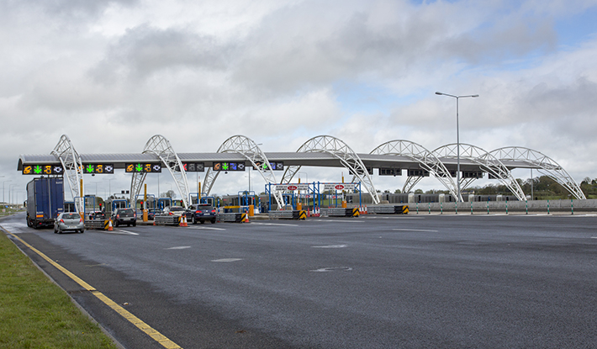
Motorway Tolls

Slide 6
Marinas

Slide 7
Advertising Stations
Heineken Sign Valuation: €125,000
Rates liability 2014: €32,125

Slide 8
Stadia
Croke Park Valuation: €4,000,000
Rates liability 2014: €1,028,000

Slide 9
Airports
Dublin Airport Valuation: €113,000,000
Rates liability 2014: €16,272,000

Slide 10
Wind Turbines

Slide 11
Rating Valuation System
Rates: “Tax” on occupation of non-domestic property
Contributes c. €1.3 billion per annum towards funding Local Authorities
Challenges:
Pace of revaluation &
Ensuring Valuation Lists are Settled and Reliable

Slide 12
Rating System
RV x ARV = Rates Liability
Rateable Valuation [RV]
Valuation Office
Annual Rate on Valuation [ARV]
Local Authority
Statutory Independent Functions

Slide 13
Revision - List Maintenance
Physical changes to properties
New Properties
Improved Properties
Demolished properties
Properties no longer used commercially

Slide 14
What is a Revaluation?
Valuation of all rateable properties
Specific valuation date
All new valuations effective on same date
Revenue Neutral – Rates Cap
Redistribution of rates liability

Slide 15
Why a Revaluation?
Rates = tax based on property rental values
Equity and Uniformity
Differential movement in rental values over time
Rental values do not change at the same pace
Restore relativity between properties, categories & locations based on Net Annual Value (rental value)
Transparency – reflect current market rental values
Independent and objective outcome
Redistribution of rates liability
Rolling revaluation: every 5-10 years

Slide 16
Revaluation – Public Policy Objectives
Equity and Uniformity
Transparency – reflect current market rental values
Redistribution of rates liability
Rolling revaluation: every 5-10 years

Slide 17
Wind Farms (pre-revaluation)
All wind farms are valued by reference to the Tone of the List.
The Tone of the List indicated that wind farms should be valued at €19,680 NAV per MW based on a Wind Capacity factor of 30%.
Information required for wind farm valuations:
Total Installed Generating Capacity (TIGC)
Wind Capacity Factor
Example:
Number of Turbines 5
Generating Capacity per Turbine 2MW
TIGC 10MW
Capacity Factor 34%
Valuation:
TIGC 10MW @ €19,680 NAV per MW €196,800 (based on Capacity Factor of 30%)
Adjusted to 34% Capacity Factor €223,040 (€196,800 multiplied by 34/30)
NAV €223,040
Apply reduction factor NAV to RV 0.5%
RV €1,115 RV (€223,040 by 0.5%)

Slide 18
Wind Farm (post revaluation)
Information required for wind farm valuations:
Financial Information
Total Installed Generating Capacity (TIGC)
Capacity Factor
Valuation Process:
Request for financial information.
Output of electricity considered to calculate the Capacity Factor.
Detailed Receipts & Expenditure valuations carried out for each site.
In Limerick the NAV per MW for site with 32% Capacity Factor was determined at €80,000.
Example:
Number of Turbines 5
Generating Capacity per Turbine 2MW
TIGC 10MW
Capacity Factor 34%
Valuation:
NAV per MW €80,000 (based on Capacity Factor of 32%)
NAV per MW adjusted to 34% Capacity Factor €85,000 (€80,000 multiplied by 34/32)
Multiplied by TIGC 10MW
NAV €850,000

Slide 19
Fundamental Principles
Valuation system based on Net Annual Value (NAV)
Equity & Fairness through Correctness and Uniformity
Production of a Valuation List which reflects estimated value of each property, on a specified date, relative to the estimated value of every other property on that list

Slide 20
Estimating the NAV - Primary Evidence

Slide 21
Key Milestones
Commissioner makes Valuation Order fixing Valuation Date
Collection and analysis of data
Rent/Lease/Tenure/Financial details
Physical property data
VO issues Proposed Valuation Certificates to Ratepayers
Representations Stage
Publication of Valuation List
Appeals before Valuation Tribunal

Slide 22
Can I Appeal My Valuation
To the Commissioner –subject to amendment
Valuation Tribunal
High & Supreme Courts
Appeal to Commissioner may be subject to legislative change

Slide 23
Summary
Fairer transparent system for all ratepayers
Revenue neutral - rates take capped
Redistribution

Slide 24
Valuation (Amendment) Act 2015
Accelerate the National Revaluation Programme
Streamline the Appeal Process
Provide for additional valuation approaches:
Self Assessment by Ratepayers
Contracting External Valuation Services and
Statistical Valuation Techniques

Slide 25
QUESTIONS

